Slide 1
DATA TASK — Dashboard Design Summary
Interactive Dashboard | Sales & Financial Dataset

Slide 2
Objective & Dataset
Objective:
Design an interactive dashboard for stakeholders to monitor Sales & Financial KPIs.
Dataset: Synthetic Sales & Financial dataset (2021-2024) with 2000 records. Columns: Date, Region, Product, Category, Quantity, UnitPrice, Sales, Profit, CustomerSegment, Year, Month.

Slide 3
KPIs & Filters
KPIs chosen:
- Total Sales
- Total Profit
- Profit Margin
- YoY Growth (2023→2024)
Filters/Slicers: Year, Region, Product Category

Slide 4
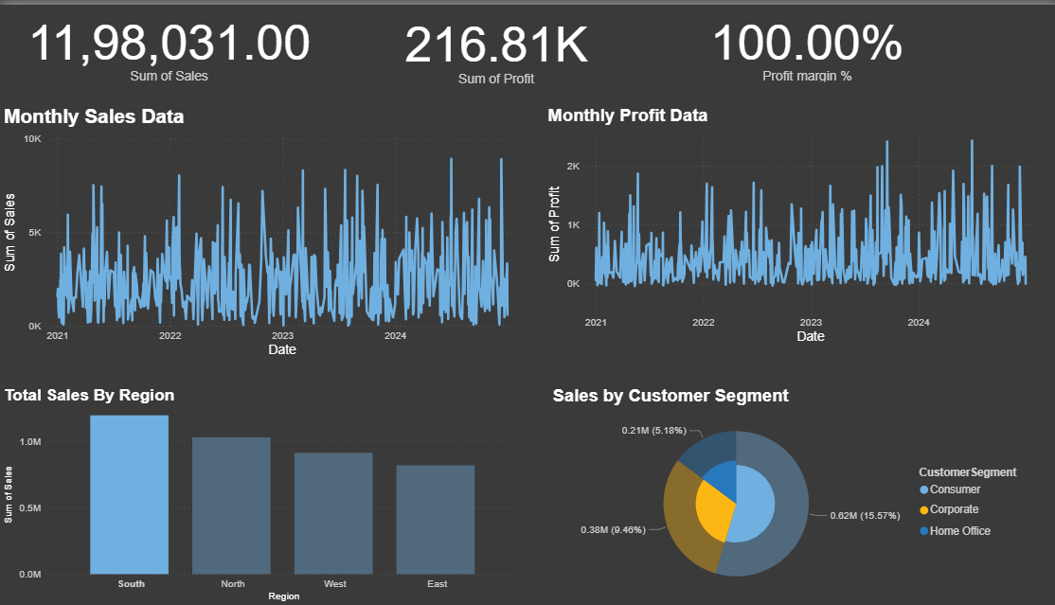
Dashboard Visuals

Slide 5
Key Insights (example)
- Average monthly sales: ₹ 82,609.33
- Top region by sales: South (₹ 1,198,031.00)
- Largest customer segment contribution: Consumer (54.6%)
- Note: Profit is volatile because of simulated discounts/returns which may cause months with low or negative profit.

Slide 6
How to Reproduce / Next Steps
How to reproduce in Power BI:
- Load the CSV (sales_financial_dataset.csv) into Power BI.
- Create measures: Total Sales, Total Profit, Profit Margin,
Build visuals: Line charts for trend, Bar for region, Pie for segments, Cards for KPIs.
- Add slicers for Year, Region, Product Category and add bookmarks/navigation if required.

